Slide 1
Unit 1 Introduction https://www.tutorialspoint.com/statistics/frequency_distribution.htm
Introduction, nature, classification and presentation of statistical data, frequency distribution, measures of central tendency, skewness and kurtosis, mean, median, quartiles and percentiles, measure of dispersion-Range, quartile deviation, mean and standard deviation, coefficient of variation. (6 hrs)

Slide 2
Introduction
Statistics is a branch of mathematics dealing with data collection, organization, analysis, interpretation and presentation.
Mathematical statistics is a branch of mathematics and generally a scientific discipline (the same as statistics).
Applied statistics, on the other hand, is a term commonly used to name courses for non-mathematically oriented audience, that teach you how to apply statistical tools for the purpose of data analysis.

Slide 3
Nature and classification of statistical data
Data is a set of values of qualitative or quantitative variables; restated, pieces of data are individual pieces of information.
Data is measured, collected and reported, and analyzed, whereupon it can be visualized using graphs or images

Slide 4
Nominal Scales
A Nominal Scale is a measurement scale, in which numbers serve as “tags” or “labels” only, to identify or classify an object.
A nominal scale measurement normally deals only with non-numeric (quantitative) variables or where numbers have no value.

Slide 5
The number gives us the identity of the category assigned.
The only mathematical operation we can perform with nominal data is to count.
Another example from research activities is a YES/NO scale, which is nominal. It has no order and there is no distance between YES and NO.

Slide 6
Characteristics of Nominal Scale
In nominal scale a variable is divided into two or more categories, for example, agree/disagree, yes or no etc. It’s is a measurement mechanism in which answer to a particular question can fall into either category.
Nominal scale is qualitative in nature, which means numbers are used here only to categorize or identify objects.
For example, football fans will be really excited, as the football world cup is around the corner! Have you noticed numbers on a jersey of a football player?

Slide 7
The number gives us the identity of the category assigned.
The only mathematical operation we can perform with nominal data is to count.
Another example from research activities is a YES/NO scale, which is nominal. It has no order and there is no distance between YES and NO.

Slide 8
Example: How would you describe your behavioral pattern?
E-Extroverted (confident),
I-Introverted (they feel more comfortable focusing on their inner thoughts and ideas, rather than what's happening externally) &
A-Ambivert (balance between extrovert and introvert)
What is your gender? Male & Female
Could you please select an option from below to describe your hair color : 1-Black, 2-Brown, 3-Burgundy, 4-Auburn, 5-Other
This scale has no numerical value. The nominal level is the lowest measurement level used from a statistical point of view.

Slide 9
Mathematical operations: Equality and other operations that can be defined in terms of equality, such as
inequality and set membership, are the
only non-trivial operations that generically apply to
objects of the nominal type.
Central tendency:
Mode, i.e. the most common item, is allowed as the measure of central tendency for the nominal type.
Median, i.e. the middle-ranked item, makes no sense for the nominal type of data since ranking is meaningless for the nominal type.

Slide 10
Ordinal Scales
Ordinal Scale is ranking of responses.
The ordinal type allows for rank order (1st, 2nd, 3rd, etc.) by which data can be sorted, but still does not allow for relative degree of difference between them.
Examples include, on one hand, dichotomous ( divided into two branches)data with dichotomous (or dichotomized) values such as 'sick' vs. 'healthy' when measuring health, 'guilty' vs. 'not-guilty' when making judgments in courts, 'wrong/false' vs. 'right/true' when measuring truth value, and, on the other hand, non-dichotomous data consisting of a spectrum of values, such as 'completely agree', 'mostly agree', 'mostly disagree', 'completely disagree' when measuring opinion.

Slide 11
Central tendency: The median, i.e. middle-ranked, item is allowed as the measure of central tendency; however, the mean (or average) as the measure of central tendency is not allowed.
The mode is allowed.
Rank in a class test (first, second or third)
Customer satisfaction ratings (On a scale of 0-10)
Customer satisfaction degrees (Very satisfied, satisfied, neutral, dissatisfied, very dissatisfied)

Slide 12
At the risk of providing a tautological definition, ordinal scales measure, well, order.
So, characteristics for ordinal scales are:
Ranked preferences are presented as an example of ordinal scales encountered in everyday life.
Order: The order of the responses or observations matters.
Distance: Ordinal scales do not hold distance. The distance between first and second is unknown as is the distance between first and third along with all observations.
True Zero: There is no true or real zero. An item, observation, or category cannot finish zero.

Slide 13
Interval Scales
Interval scales provide insight into the variability of the observations or data.
Classic interval scales are Likert scales (e.g., 1 - strongly agree and 9 - strongly disagree) and
Semantic (logic) Differential scales (e.g., 1 - dark and 9 - light).
In an interval scale, users could respond to “I enjoy opening links to the website from a company email” with a response ranging on a scale of values.

Slide 14
The characteristics of interval scales are:
Order: The order of the responses or observations does matter.
Distance: Interval scales do offer distance. That is, the distance from 1 to 2 appears the same as 4 to 5. Also, six is twice as much as three and two is half of four.
Hence, we can perform arithmetic operations on the data.
True Zero: There is no zero with interval scales. However, data can be rescaled in a manner that contains zero. An interval scales measure from 1 to 9 remains the same as 11 to 19 because we added 10 to all values. Similarly, a 1 to 9 interval scale is the same a -4 to 4 scale because we subtracted 5 from all values. Although the new scale contains zero, zero remains uninterpretable because it only appears in the scale from the transformation.
Unless a web analyst is working with survey data, it is doubtful he or she will encounter data from an interval scales. More likely, a web analyst will deal with ratio scales (next section).
Appropriate statistics for interval scales: count, frequencies, mode, median, mean, standard deviation (and variance), skewness, and kurtosis.
Displays: histograms or bar charts, line charts, and scatter plots.

Slide 15
Ratio Scales
Ratio scales appear as nominal scales with a true zero.
Ratio scale is a type of variable measurement scale which is quantitative in nature.

Slide 16
They have the following characteristics:
Order: The order of the responses or observations matters.
Distance: Ratio scales do have an interpretable distance.
True Zero: There is a true zero.
Income is a classic example of a ratio scale:
Order is established. We would all prefer $100 to $1!
Zero dollars means we have no income (or, in accounting terms, our revenue exactly equals our expenses!)
Distance is interpretable, in that $20 appears as twice $10 and $50 is half of a $100.
In web analytics, the number of visits and the number of goal completions serve as examples of ratio scales. A thousand visits is a third of 3,000 visits, while 400 goal completions are twice as many as 200 goal completions. Zero visitors or zero goal completions should be interpreted as just that: no visits or completed goals.
For the web analyst, the statistics for ratio scales are the same as for interval scales.
Appropriate statistics for ratio scales: count, frequencies, mode, median, mean, standard deviation (and variance), skewness, and kurtosis.
Displays: histograms or bar charts, line charts, and scatter plots.

Slide 17
Overview of scales
Incremental | Measure property | Mathematical | Advanced | Central
progress |  | operators | operations | tendency
Nominal | Classification, membership | =, ≠ | Grouping | Mode
Ordinal | Comparison, level | >, < | Sorting | Median
Interval | Difference, affinity | +, − | Yardstick | Mean,
 |  |  |  | Deviation
Ratio | Magnitude, amount | ×, / | Ratio | Geometric mean,
 |  |  |  | Coefficient of variation

Slide 18
Classification of data
Qualitative data: Qualitative research is a scientific method of observation to gather non-numerical data. This type of research "refers to the meanings, concepts, definitions, characteristics, metaphors, symbols, and description of things" and not to their "counts or measures“.
Quantitative data: Quantitative data is data expressing a certain quantity, amount or range. Usually, there are measurement units associated with the data, e.g. metres, in the case of the height of a person. It makes sense to set boundary limits to such data, and it is also meaningful to apply arithmetic operations to the data.

Slide 19
Spatial data: A spatial database is a database that is optimized for storing and querying data that represents objects defined in a geometric space. Most spatial databases allow the representation of simple geometric objects such as points, lines and polygons.
Chronological data: When data are observed over a period of time the type of classification is known as chronological classification ( on the basis of its time of occurrence ).

Slide 20
Presentation of statistical data
Tabular Presentation
Frequency
Relative frequency of X₁=actual frequency of X₁*100/sum of all frequencies
Cumulative frequency= frequency of present data+ frequency of just previous data

Slide 21
Tabular presentation
The definition of tabular is presented in rows and columns. An example of something tabular is data presented in an Excel spreadsheet; a tabular presentation of data.
Characteristics of table
1. Table name:
2. Title of The Table -A table is a brief explanation of the contents of a table. It explains all those information which are related to data. A good title is short and clear but complete in all respects.
3. Caption or Column Heading A word or a phrase which explains the contents of a column table is called caption. Under caption, there may be sub-heads when information contained in the columns is divided in more than one class.
4. Stubs or Row Headings -Stubs are title of the rows of a table. These titles indicate information contained in the row of the table. The complete left column is called the stub column.
5. Body of The Table - Body of a table means sum total of the items in the table. It indicates the value of the various items in the table. Each item in the body is called ‘cell’

Slide 22
A simple table here means means that there is a maximum of one header row and one header column where a header column specifies the type of information in the column. In addition, there are no merged cells within a simple table. Below are examples of simple and complex tables.
Complex Table. The complex table definition defines a table of records containing multiple fields stored on the Agentry Client in a structured and searchable format. ... The complex table definition also defines how its data is synchronized. The fields and indexes of a complex table define the structure of the records.

Slide 23
Types of table
Food habit
A. Simple table
SN | Description | Food habit | Remarks
1 | Ram | Vegetarian
2 | Sam | Non-veg
3 | Sita | Preferably bread

Slide 24
B. Complex table
Village | Ward2 |  | Ward3
 | Male | Female | Male | Female
A | 45 | 55 | 65 | 76
V | 95 | 93 | 85 | 93
S | 86 | 67 | 67 | 65
T | 56 | 76 | 34 | 56
Village | Group | Ward2 |  | Ward3
 |  | Male | Female | Male | Female
A | Kids | 23 | 22 | 22 | 19
 | Adult | 45 | 55 | 65 | 76
V | Kids | 95 | 93 | 85 | 93
 | Adult | 76 | 78 | 74 | 71
S | Kids | 86 | 67 | 67 | 65
 | Adult | 84 | 81 | 81 | 84
T | Kids | 56 | 76 | 34 | 56
 | Adult | 55 | 72 | 38 | 55

Slide 25
Graphing frequency distribution
Histogram
Frequency polygon
Ogive (less than & more than)

Slide 26
Discrete classes
Discrete data can only take particular values. There may potentially be an infinite number of those values, but each is distinct and there's no grey area in between.
Discrete data can be numeric (integer or count value)- like numbers of apples -but it can also be categorical -like red or blue, or male or female, or good or bad.

Slide 27
Discrete class
Number of children | Number of women
0 | 12
1 | 18
2 | 10
3 | 6
4 | 4
5 | 2

Slide 28
Frequency distribution
A mathematical function showing the number of instances in which a variable takes each of its possible values.
Frequency distribution is a representation, either in a graphical or tabular format, that displays the number of observations within a given interval. The intervals must be mutually exclusive and exhaustive, and the interval size depends on the data being analyzed and the goals of the analyst. Frequency distributions are typically used within a statistical context.
A frequency distribution table is a chart that summarizes values and their frequency. It's useful way to organize data if you have a list of numbers that represent the frequency of a certain outcome in a sample.
A frequency distribution table has two columns. The first column lists all the various outcomes that occur in the data, and the second column lists the frequency of each outcome.
Basket | Number of apple (frequency)
Orange color | 45
Red color | 21
Blue color | 32
Green color | 44
Method | Frequency distribution
Simple random | 45
Stratified random | 21
Systematic | 32
Cluster Sampling | 44

Slide 29
Frequency are mainly cumulative frequencies, relative frequencies, and cumulative relative frequencies .
Relative frequency of X_{i}=100*(actual frequency of X_{i})/(sum of all frequencies)
Cumulative frequency of X_{i} = sum of all frequencies of all values up to and including X_{i}.

Slide 30
Method | Frequency distribution | Cumulative frequency | Relative frequency | Cumulative relative frequency
Simple random | 45
Stratified random | 21
Systematic | 32
Cluster Sampling | 44
Total | 142
Calculate:
i. Cumulative frequency
ii. Relative frequency
iii. Cumulative relative frequency

Slide 31
Method | Frequency distribution | Cumulative frequency | Relative frequency | Cumulative relative frequency
Simple random | 45 | 45 | 31.69 | 31.69
Stratified random | 21 | 66 | 14.79 | 46.48
Systematic | 32 | 98 | 22.54 | 69.01
Cluster Sampling | 44 | 142 | 30.99 | 100.00
Total | 142 |  | 100.00
Village
 | No (frequency) | Cumulative frequency | Relative frequency | Cumulative Relative frequency
A | 123
B | 145
C | 155
D | 166
E | 176
F | 179
Calculate the relative & cumulative relative frequency

Slide 32
Discrete data
No of students getting marks | Marks secured | Cumulative Frequency | Relative frequency | Cumulative Relative Frequency
4 | 80
3 | 90
5 | 78
3 | 79
2 | 57
Calculate the cumulative, relative frequency and cumulative relative frequency

Slide 33
Continuous class
A continuous variable is one which can take on infinitely many, uncountable values.
Class interval (inclusive) | Frequency
0-4.9 | 6
5-9.9 | 6
10-14.9 | 13
15-19.9 | 11
20-24.9 | 12
25-29.9 | 2
Class interval (Exclusive) | Frequency
0-5 | 6
5-10 | 6
10-15 | 13
15-20 | 11
20-25 | 12
25-30 | 2
Calculate the cumulative, relative frequency and cumulative relative frequency

Slide 34
Histogram
Histogram is a series of rectangles attached to one another. Each rectangle is proportional in width with range in a class and proportional in height to the number of observations in the class. Usually, in a frequency distribution, class width in same for all classes. Consequently, the vertical in a histogram have equal width
Village | Number of dumping site
A | 4
B | 5
C | 6
D | 7
E | 9
Village | Number of dumping site
A | 1
B | 2
C | 3
D | 4
E | 5
Draw the histogram from this table
Draw the histogram from this table

Slide 36
Class interval (Exclusive) | Frequency
0-5 | 6
5-10 | 6
10-15 | 13
15-20 | 11
20-25 | 12
25-30 | 2
Draw the histogram from this table

Slide 37
Frequency polygon
When frequencies are plotted in Y axis against mid-value of classes in X axis, the resulting line graph after joining these plots is known as frequency polygon. In this beginning and end classes are added with zero.
The frequency polygon that uses relative frequencies of data points in each of the classes rather than the actual number of points is called relative frequency polygon.

Slide 38
Class | No fo students
A | 0
B | 12
C | 18
D | 10
E | 6
F | 4
G | 0
Draw the frequency polygon from above table

Slide 40
Class | No fo students
A | 0
B | 6
C | 9
D | 14
E | 9
F | 2
G | 0
Draw the frequency polygon from above table

Slide 41
Ogive
A graph of cumulative frequency distribution is called ogive. There are 2 types of ogive.
Less than ogive and
Greater than ogive

Slide 42
Marks | Number of students | Number of students (less than ogive) | Number of students (More than ogive)
0 | 0
10 | 7
20 | 10
30 | 12
40 | 22
50 | 6
60 | 3
Calculate :
Number of students (less than ogive)
Number of students (more than ogive)
& draw ogive diagram

Slide 43
Marks | Number of students | Number of students (less than ogive) | Number of students (More than ogive)
0 | 0 | 0 | 60
10 | 7 | 7 | 53
20 | 10 | 17 | 43
30 | 12 | 29 | 31
40 | 22 | 51 | 9
50 | 6 | 57 | 3
60 | 3 | 60 | 0

Slide 44
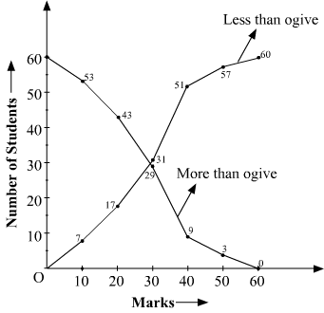

Slide 45
Marks | Number of students | Number of students (less than ogive) | Number of students (More than ogive)
0 | 0
80 | 9
90 | 11
70 | 17
75 | 21
67 | 9
60 | 11
Calculate & draw ogive diagram
:
Number of students (less than ogive)
Number of students (more than ogive)

Slide 46
More than ogive

Slide 47
Diagrammatic presentation
Bar Diagram
Pie diagram or pie chart
Steam leaf display

Slide 48
Bar diagram
Define the bar diagram & also draw it based on given data set
Marks | Number of students
0 | 0
80 | 9
90 | 11
70 | 17
75 | 21
67 | 9
60 | 11
A bar chart or bar graph is a chart or graph that presents categorical data with rectangular bars with heights or lengths proportional to the values that they represent. The bars can be plotted vertically or horizontally. A vertical bar chart is sometimes called a column chart.

Slide 50
Draw the bar diagram
Village | Ward2 |  | Ward3
 | Male | Female | Male | Female
A | 45 | 55 | 65 | 76
V | 95 | 93 | 85 | 93
S | 86 | 67 | 67 | 65
T | 56 | 76 | 34 | 56
Village | Group | Ward2 |  | Ward3
 |  | Male | Female | Male | Female
A | Kids | 23 | 22 | 22 | 19
 | Adult | 45 | 55 | 65 | 76
V | Kids | 95 | 93 | 85 | 93
 | Adult | 76 | 78 | 74 | 71
S | Kids | 86 | 67 | 67 | 65
 | Adult | 84 | 81 | 81 | 84
T | Kids | 56 | 76 | 34 | 56
 | Adult | 55 | 72 | 38 | 55

Slide 51
Pie diagram or pie chart
A pie chart divides a numerical figure representing a particular quantitative phenomenon into different segments
The total numerical figure is represented by a complete circle with 360⁰. The division of the circle to different segments is done by drawing straight lines from centre to circumference. This proportion of a quantitative value to a total numerical figure.
Fuel type | Present distribution
Electricity | 39.8
Kerosene | 57.5
Others | 2.5
Draw the pie chart

Slide 52
Fue type | Present distribution | Angle
Electricity | 39.8 | 143.5671
Kerosene | 57.5 | 207.4148
Others | 2.5 | 9.018036

Slide 53
Steam and Leaf display
A display data in sequential order by ranks of items in a data set. To construct a steam and leaf display, first of all a vertical list of steams (distinct first digits of data) is made. Then a vertical line to the right side of these stems is drawn. Then leaves (next digits of the items) are listed one by one in the order as given in the data. Example
79, 78, 78, 67, 76, 87, 85, 74, 66, 99, 84, 72, 66, 57, 94, 84, 72, 63, 51, 48, 50, 61, 71, 82, 93, 100, 89
Display the steam leaf of above data set

Slide 54
4 | 8
5 | 7 | 1 | 0
6 | 7 | 6 | 6 | 3 | 1
7 | 9 | 8 | 8 | 6 | 3 | 2 | 2 | 1
8 | 7 | 5 | 4 | 4 | 4 | 2 | 9
9 | 9 | 4 | 3
10 | 0

Slide 55
Display stem and leaf diagram of following data set
40,44,45,57,58,59,52,68,63,64,66,66,72,73,75,79,79,88,87,84,82,92,93,94,101

Slide 56
Frequency
Simple Frequency Distribution: Simple frequency distribution is used to organize orderly the larger data sets. When the number of cases being studied is large, it is inconvenient to list them separately because the list would be too long.
A simple frequency distribution shows the number of times each score occurs in a set of data.
To find the frequency for score count how many times the score occurs

Slide 57
Grouped Frequency Distribution: A grouped frequency distribution is an ordered listed of a variable XX, into groups in one column with a listing in a second column, the frequency column. A grouped frequency distribution is an arrangement class intervals and corresponding frequencies in a table.
Age Class in village | Frequency | Cumulative frequency | Relative frequency | Cumulative relative frequency
0 to 10 | 6 | 6 | 18.75 | 18.75
10 to 20 | 8 | 14 | 25.00 | 43.75
21 to 30 | 9 | 23 | 28.13 | 71.88
31 to 40 | 1 | 24 | 3.13 | 75.00
41 to 50 | 8 | 32 | 25.00 | 100.00

Slide 58
Measures of central tendency
In statistics, a central tendency (or measure of central tendency) is a central or typical value for a probability distribution. It may also be called a center or location of the distribution. Colloquially, measures of central tendency are often called averages. The term central tendency dates from the late 1920s.
The most common measures of central tendency are the arithmetic mean, the median and the mode. A central tendency can be calculated for either a finite set of values or for a theoretical distribution, such as the normal distribution. Occasionally authors use central tendency to denote "the tendency of quantitative data to cluster around some central value."

Slide 59
Mean, median, quartiles and percentiles
Arithmetic Mean in the most common and easily understood measure of central tendency. We can define mean as the value obtained by dividing the sum of measurements with the number of measurements contained in the data set and is denoted by the symbol x¯.
Arithmetic Mean for three types of series:
Individual Data Series
Discrete Data Series
Continuous Data Series

Slide 60
Individual Data Series: When data is given on individual basis. Following is an example of individual series:
Items | 5 | 10 | 20 | 30 | 40 | 50 | 60 | 70
Mean=35.625
Discrete Data Series: When data is given along with their frequencies. Following is an example of discrete series:
 | Item no |  |  |  |  |  |  |  | Total
Items (i) | 5 | 10 | 20 | 30 | 40 | 50 | 60 | 70 | 285
Frequency (f) | 2 | 5 | 1 | 3 | 12 | 0 | 5 | 7 | 35
F*i | 10 | 50 | 20 | 90 | 480 | 0 | 300 | 490 | 1440
Mean= 8.142857
Mean=1440/35= 41.14286

Slide 61
Calculate the mean from following data set
 | Item no |  |  |  |  |  |  |  | Total
Items (i) | 11 | 13 | 15 | 16 | 20 | 21 | 24 | 31
Frequency (f) | 8 | 8 | 11 | 21 | 3 | 4 | 3 | 2
F*i

Slide 62
\
Continuous Data Series
Items | 0-5 | 5-10 | 10-20 | 20-30 | 30-40 | Total
Frequency (f) | 2 | 5 | 1 | 3 | 12 | 23
Mid value (n) | 2.5 | 7.5 | 15 | 25 | 35
F*n | 5 | 37.5 | 15 | 75 | 420 | 552.5
Mean=552.5/23= 24.02174

Slide 63
Calculate the mean from continuous data
Weight of orange | Frequency
0-10 | 4
10-15 | 6
15-20 | 7
20-30 | 8
30-35 | 1
35-40 | 2

Slide 64
Examples
pH value (x) | x-a | pH value (x) | x-a | pH value (x) | x-a
4.4 | -2.6 | 6.2 | -0.8 | 8 | 1
4.5 | -2.5 | 6.3 | -0.7 | 8.1 | 1.1
4.6 | -2.4 | 6.4 | -0.6 | 8.2 | 1.2
4.7 | -2.3 | 6.5 | -0.5 | 8.4 | 1.4
4.8 | -2.2 | 6.6 | -0.4 | 7.2 | 0.2
4.9 | -2.1 | 6.7 | -0.3 | 8.6 | 1.6
5 | -2 | 6.8 | -0.2 | 7 | 0
5.1 | -1.9 | 6.9 | -0.1 | 8.8 | 1.8
5.2 | -1.8 | 7 | 0 | 8.9 | 1.9
5.3 | -1.7 | 7.1 | 0.1 | 7.8 | 0.8
5.4 | -1.6 | 7.2 | 0.2 | 7.9 | 0.9
5.5 | -1.5 | 7.3 | 0.3 | 6.7 | -0.3
5.8 | -1.2 | 7.4 | 0.4 | 6.8 | -0.2
5.7 | -1.3 | 7.5 | 0.5 | 6.9 | -0.1
5.8 | -1.2 | 7.6 | 0.6 | 6.9 | -0.1
5.9 | -1.1 | 7.7 | 0.7 | 7 | 0
6 | -1 | 7.8 | 0.8 | 7 | 0
6.1 | -0.9 | 7.9 | 0.9 | 7.3 | 0.3
6 | -1 | 7.2 | 0.2 | 7.7 | 0.7
5.5 | -1.5 | 7.9 | 0.9 | 7.8 | 0.8
 |  |  | -7 | 7.8 | 0.8
Sum | -33.8 | 7.2 | 0.2 | 7.1 | 0.1
 |  | 7.3 | 0.3 | Sum | 13.9
Assume a 7 |  | Sum | 0.3
sum (x-a) | -19.6
Mean = a+(x-a)/n=(7+(-19.6/60))=6.67

Slide 65
Requisites of ideal average
It should be rigidly defined based on observations, should be suitable for further mathematical treatment, it should be least affected due to sampling, but much affected by extreme values
Merit & demerits: easy to calculate & understand, every data set has single mean, less affected due to sampling, but much affected by extreme values, cannot be calculated from frequency distribution & qualitative observation
Properties of mean:
Sum of X-mean is 0. Sum of square of deviation of a data set is minimum when taken from mean
If n1 and n2 be the number

Slide 66
Median
The median is a simple measure of central tendency. To find the median, we arrange the observations in order from smallest to largest value. If there is an odd number of observations, the median is the middle value. If there is an even number of observations, the median is the average of the two middle values.
The median formula is {(n + 1) ÷ 2}th, where “n” is the number of items in the set and “th” just means the (n)th number. To find the median, you must first order the numbers from smallest to largest. Then find the middle number. For example, the middle for this set of numbers is 5, because 5 is right in the middle: 1, 2, 3, 5, 6, 7, 9. You get the same result with the formula. There are 7 numbers in the set, so n=7: {(7 + 1) ÷ 2}th = {(8) ÷ 2}th = {4}th The 4th number in 1, 2, 3, 5, 6, 7, 9 is 5.

Slide 67
Sample question: Find the median for the following data set: 102, 56, 34, 99, 89, 101, 10. Step 1: Place the data in ascending order. In other words, sort your data from the smallest number to the highest number. For this sample data set, the order is: 10, 34, 56, 89, 99, 101, 102. Step 2: Find the number in the middle (where there are an equal number of data points above and below the number): 10, 34, 56, 89, 99, 101, 102. The median is 89. Tip: If you have a large data set, divide the number in the set by two. That tells you how many numbers should be above and how many numbers should be below. For example, 101/2 = 55.5. Ignore the decimal: 55 numbers should be above and 55 below.

Slide 68
Find the median for an even set of numbers
Sample question: Find the median for the following data set: 102, 56, 34, 99, 89, 101, 10, 54. Step 1: Place the data in ascending order (smallest to highest). 10, 34, 54, 56, 89, 99, 101, 102. Step 2: Find the TWO numbers in the middle (where there are an equal number of data points above and below the two middle numbers). 10, 34, 54, 56, 89, 99, 101, 102 Step 3: Add the two middle numbers and then divide by two, to get the average: 56 + 89 = 145 145 / 2 = 72.5. The median is 72.5. Tip: For large data sets, divide the number of items by 2, then subtract 1 to find the number that should be above and the number that should be below. For example, 100/2 = 50. 50 – 1 = 49. The middle two numbers will have 49 items above and 49 below. That’s it!

Slide 69
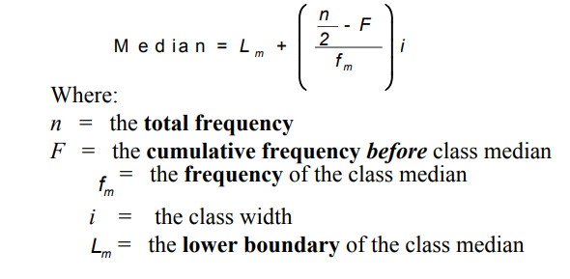
Median– Grouped Data
Step 1: Construct the cumulative frequency distribution.
Step 2: Decide the class that contain the median. Class Median is the first class with the value of cumulative frequency equal at least n/2. Step
3: Find the median by using the following formula:

Slide 70
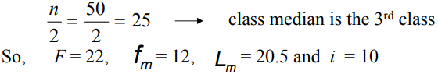
Problem
Time to travel to work | Frequency
1 – 10 | 8
11 – 20 | 14
21 – 30 | 12
31 – 40 | 9
41 – 50 | 7
Solution
1st Step: Construct the cumulative frequency distribution
IInd step: Find the median class
Time to travel to work | Frequency | Cumulative frequency
1 – 10 | 8 | 8
11 – 20 | 14 | 22
21 – 30 | 12 | 34
31 – 40 | 9 | 43
41 – 50 | 7 | 50

Slide 71
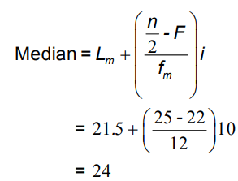
Therefore,
Thus, 25 persons take less than 24 minutes to travel to work and another 25 persons take more than 24 minutes to travel to work.

Slide 72
Merits & demerits of median
Like arithmetic mean it is simple to calculate & understand
Since it is positonal average, it is not affected by extreme values, for open ended class it is the most appropriate average
Its value can also be gradually determined by plotting upper class boundaries & cumulative frequencies, it can be calculated ordered qualitative characteristics, it is more representative than arithmatic mean & mode when a distribution is highly skewed
It is not always rigidly defined. For example if the number of observation is even there are 2 middle values
certain statistical procedure that use median are more complex

Slide 73
Mode
The "mode" is the value that occurs most often. If no number in the list is repeated, then there is no mode for the list.
Example: 3, 7, 5, 13, 20, 23, 39, 23, 40, 23, 14, 12, 56, 23, 29
In order these numbers are:
3, 5, 7, 12, 13, 14, 20, 23, 23, 23, 23, 29, 39, 40, 56
This makes it easy to see which numbers appear most often.
In this case the mode is 23.

Slide 74
Example: Another Example: {19, 8, 29, 35, 19, 28, 15}
Arrange them in order: {8, 15, 19, 19, 28, 29, 35}
19 appears twice, all the rest appear only once, so 19 is the mode.
We can have more than one mode.

Slide 75
Grouping
Example: {4, 7, 11, 16, 20, 22, 25, 26, 33}
Each value occurs once, so let us try to group them.
We can try groups of 10:
0-9: 2 values (4 and 7)
10-19: 2 values (11 and 16)
20-29: 4 values (20, 22, 25 and 26)
30-39: 1 value (33)
In groups of 10, the "20s" appear most often, so we could choose 25 (the middle of the 20s group) as the mode.
You could use different groupings and get a different answer.

Slide 76

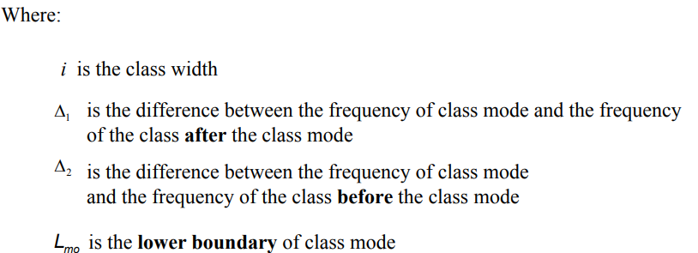
Mode – Grouped Data

Slide 77
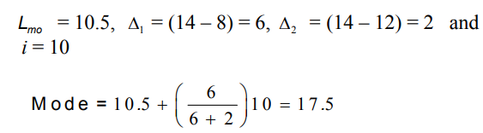
Problem
Time to travel to work | Frequency
1 – 10 | 8
11 – 20 | 14
21 – 30 | 12
31 – 40 | 9
41 – 50 | 7
Solution:
Based on the table,

Slide 78
Calculate Mode
X | 20 | 21 | 22 | 23 | 24 | 25 | 26 | 27 | 28 | 29
F | 6 | 9 | 4 | 2 | 10 | 8 | 7 | 5 | 1 | 3
X | Column 1 frequency | Column 2 | Column 3 | Column 4 | Column 5 | Column 6
 |  |  | leave first & sum 2 frequency | sum 3 frequencies | leave first & sum 3 frequencies | leave first/second & sum 3 frequencies
20 | 6 |  | leave |  | leave | leave
21 | 9 | 15 |  |  |  | leave
22 | 4 |  | 13 | 19
23 | 2 | 6 |  |  | 15
24 | 10 |  | 12 |  |  | 16
25 | 8 | 18 |  | 20
26 | 7 |  | 15 |  | 25
27 | 5 | 12 |  |  |  | 20
28 | 1 |  | 6 | 13
29 | 3 | 4 |  |  | 9

Slide 79
 | 20 | 21 | 22 | 23 | 24 | 25 | 26 | 27 | 28 | 29
Column 1 |  |  |  |  | 1
Column 2 |  |  |  |  | 1 | 1
Column 3 |  |  |  |  |  | 1 | 1
Column 4 |  |  |  | 1 | 1 | 1
Column 5 |  |  |  |  | 1 | 1 | 1
Column 6 |  |  |  |  |  | 1 | 1 | 1
Total |  |  |  | 1 | 4 | 5 | 3 | 1
Highest frequency is of 25 with 5 so, this is the Mode

Slide 80
Calculate the medien and mode from following data set
Time to travel to work | Frequency
1 – 5 | 7
6 – 10 | 16
11 – 15 | 11
16 – 20 | 8
21 – 25 | 9

Slide 81
Merits & demerits of mode
It can be calculated for ordered qualitative characteristics, it not usually affected due to extreme values, it can be computed even some classes are open ended, it can be determined graphically by constructing histogram
It is not rightly defined, occasionally no values occur more than once & therefore, there no model value, some time same number of times then each is mode
It is not based up on observation
as compared to mean, mode is affected more by sample fluctuation

Slide 82
Comparing mean, median and mode
Symmetrical distributions have approximately common mean, median and mode.

Slide 83
Measure of dispersion-Range, quartile deviation
In statistics, dispersion (also called variability, scatter, or spread) is the extent to which a distribution is stretched or squeezed.
Common examples of measures of statistical dispersion are the variance, standard deviation, and interquartile range.

Slide 84
The range is defined as the difference between the largest score in the set of data and the smallest score in the set of data.

Slide 85
Partition values
Quartile, deciles and percentiles are the known as partition vlues
Decile= first decile= (n+1)/10 th item in data set
Second decile=2(n+1)/10 th item in data set
First percentile= (n+1)/100 th item in data set
Second percentile= 2(n+1)/100 th item in data set

Slide 86
Quartile
A quartile is a type of quantile. The first quartile (Q₁) is defined as the middle number between the smallest number and the median of the data set.
The second quartile (Q₂) is the median of the data.
The third quartile (Q₃) is the middle value between the median and the highest value of the data set.

Slide 87



.
1: Find the first and third quartiles of the data set {3, 7, 8, 5, 12, 14, 21, 13, 18}
First, we write data in increasing order: 3, 5, 7, 8, 12, 13, 14, 18, 21.
As on the previous page, the median is 12.
Therefore, the lower half of the data is: {3, 5, 7, 8}.
The first quartile, Q₁, is the median of {3, 5, 7, 8}.
Since there is an even number of values, we need the mean of the middle two values to find the first quartile:
Similarly, the upper half of the data is: {13, 14, 18, 21}, so,

Slide 88
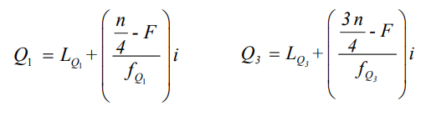
Using the same method of calculation as in the Median, we can get Q1 and Q3 equation as follows
Where, n= total frequency
F= cumulative frequency of before quartile class
fQ= frequency of quartile class
LQ= lower limit of quartile class
i= class interval

Slide 89
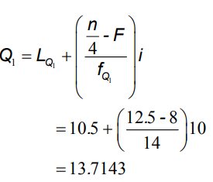
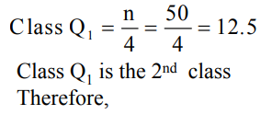
Problem
Time to travel to work | Frequency
1 – 10 | 8
11 – 20 | 14
21 – 30 | 12
31 – 40 | 9
41 – 50 | 7
Time to travel to work | Frequency | Cumulative frequency
1 – 10 | 8 | 8
11 – 20 | 14 | 22
21 – 30 | 12 | 34
31 – 40 | 9 | 43
41 – 50 | 7 | 50
1st Step: Construct the cumulative frequency distribution
2nd Step: Determine the Q1 and Q3

Slide 90

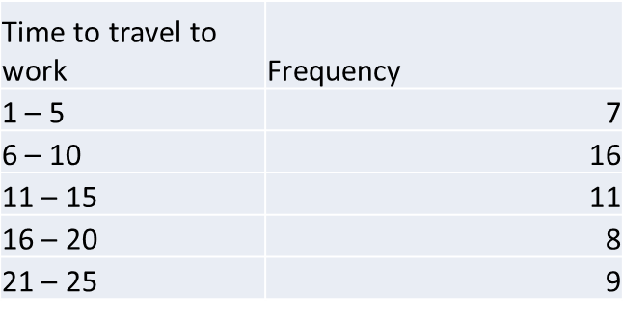
Q3= LQ3+ {(3n/4-f)/fq3}*I
Q3=34.38
Class Q3 is the 4th class
Inter quartile Range
IQR = Q3 – Q1
IQR = Q3 – Q1 = 34.3889 – 13.7143 = 20.6746
Find the inter quartile range from following data set

Slide 91


Mean and standard deviation
The Variance is the average of the squared differences from the Mean. the standard deviation tells us how all the observations in the variable are distributed or clustered about the mean of the variable.
variable | Dataset
X1 | 3
X2 | 4
X3 | 4
X4 | 5
X5 | 6
X6 | 8
variable | Dataset (x) | X-mean X | Square of (X-X mean)
X1 | 3 | -2 | 4
X2 | 4 | -1 | 1
X3 | 4 | -1 | 1
X4 | 5 | 0 | 0
X5 | 6 | 1 | 1
X6 | 8 | 3 | 9
 | 30 |  | 16
Sum of x= 30
Mean =30/6=5
Find the varience & standard deviation
If the variance is small, then the data is very closely dispersed around the mean, i.e. the data points are close in value to the mean. If the variance is large, then the data is more widely dispersed around the mean, i.e. the data points are different from the mean.

Slide 92
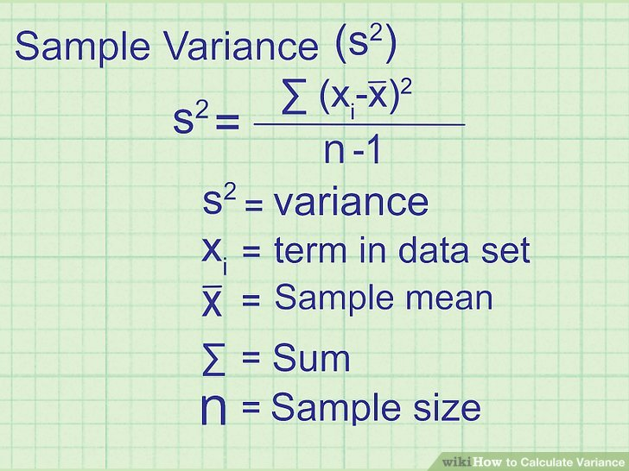
Standard deviation= square root of variance
Coefficient of variance = Standard deviation/ mean

Slide 93
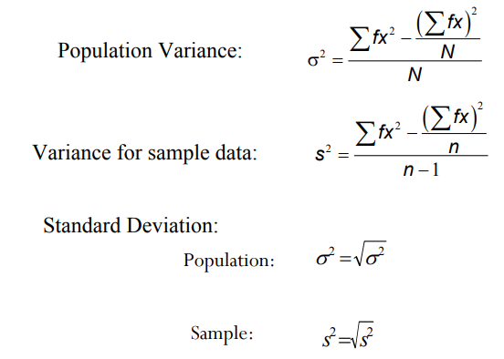
Grouped data set

Slide 94
Solution
Problem
No of order | Frequency f
10 – 12 | 4
13 – 15 | 12
16 – 18 | 20
19 – 21 | 14
No of order | Frequency | Xm | f*Xm | squre of f*Xm
10 – 12 | 4 | 11 | 44 | 1936
13 – 15 | 12 | 14 | 168 | 28224
16 – 18 | 20 | 17 | 340 | 115600
19 – 21 | 14 | 20 | 280 | 78400
 |  |  |  | 224160
Variance = 4206. 31
Standard deviation= 64.85
Calculate the variance & standard deviation from following data set
No of orderr | Frequency
5 to 7 | 7
8 to 10 | 8
11 to 13 | 9
14 to 16 | 11

Slide 95
Properties of Standard deviation
Standard deviation is only used to measure spread or dispersion around the mean of a data set.
Standard deviation is never negative.
Standard deviation is sensitive to outliers. A single outlier can raise the standard deviation and in turn, distort the picture of spread.
For data with approximately the same mean, the greater the spread, the greater the standard deviation.
If all values of a data set are the same, the standard deviation is zero (because each value is equal to the mean).

Slide 96
Coefficient of variation
A coefficient of variation (CV) is a statistical measure of the dispersion of data points in a data series around the mean. It is calculated as follows: (standard deviation sd) / (expected value mean value). The coefficient of variation represents the ratio of the standard deviation to the mean, and it is a useful statistic for comparing the degree of variation from one data series to another, even if the means are drastically different from one another.

Slide 97
Co-efficient of variance
No of order (x) | Frequency (f) | fx | x- mean | squre of x-mean
5 | 7 | 35 | -4.8 | 23.04
8 | 8 | 64 | -1.8 | 3.24
10 | 9 | 90 | 0.2 | 0.04
14 | 11 | 154 | 4.2 | 17.64
 | 35 | 343 |  | 43.96
 |  | mean | 9.8
No of order (x) | Frequency (f) | fx | x- mean | Square of x- mean
8 | 7 | 56 | 3.83 | 14.67
9 | 8 | 72 | 2.83 | 8.01
11 | 9 | 99 | 0.83 | 0.69
17 | 11 | 187 | -5.17 | 26.73
 | 35 | 414 |  | 50.10
 | Mean | 11.82857 | Standard deviation | 1.20
 | Variance | 1.431303 | CV2 | 0.10114245
variance | 1.256
Standard deviation | 1.120714 | CV1 | 0.892288
Coefficient of variance = Standard deviation/ mean
Which data set is more consistence (CV)?
CV2<CV1 therefore, second set of data is more consistence

Slide 98
Data set 1
No of order (x) | Frequency (f)
11 | 11
14 | 2
16 | 4
19 | 10
Data set 2
No of order (x) | Frequency (f)
15 | 4
2 | 9
14 | 8
21 | 2
Calculate the coefficient of variance (CV) and suggest which data set is more consistence

Slide 99
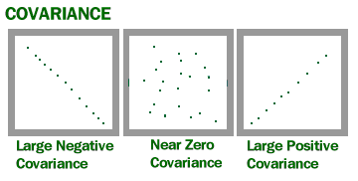
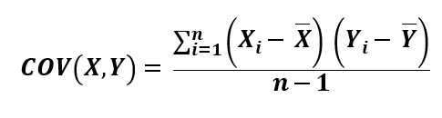
Measures of Association: Covariance, Correlation
Covariance is a measure of how much two random variables vary together. It’s similar to variance, but where variance tells you how a single variable varies, co variance tells you how two variables vary together.
A large covariance can mean a strong relationship between variables. However, you can’t compare variances over data sets with different scales (like pounds and inches). A weak covariance in one data set may be a strong one in a different data set with different scales.

Slide 100
SN | English (X) | Math (Y) | X-X mean | Y-y mean | (X-X mean)*(Y-Y mean)
1 | 65 | 100 | 9 | -17.33 | -161.78
2 | 76 | 67 | -2 | 15.67 | -26.15
3 | 61 | 56 | 13 | 26.67 | 355.37
4 | 86 | 94 | -12 | -11.33 | 132.33
5 | 88 | 81 | -14 | 1.67 | -22.69
6 | 70 | 98 | 4 | -15.33 | -66.42
 | 74 | 82.66667 | -2 | 0.02 | 210.66
Cov= 42.13
X | Y
52 | 87
63 | 54
48 | 43
73 | 81
75 | 68
57 | 85
Calculate the covariance from following data series

Slide 101
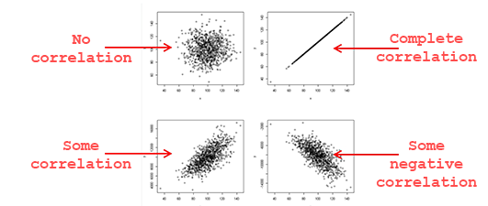
Correlation
a mutual relationship or connection between two or more things.
If we have a series of n measurements of X and Y written as x_{i} and y_{i} for i = 1, ..., n, then the sample correlation coefficient can be used to estimate the population Pearson correlation r between ^{X and} Y. The sample correlation coefficient is written as
Correlation R= Ɛdx*dy / sqrt(Ɛdx²*Ɛdy²)
Ɛdx*dy = Ɛx*y – (Ɛx* Ɛy / n)
Ɛdx² =Ɛx²-{(Ɛx)² / n}
Ɛdy²=Ɛy²-{(Ɛy)² / n}

Slide 102
SUBJECT | AGE X | GLUCOSE LEVEL Y | XY | X2 | Y2
1 | 43 | 99 | 4257 | 1849 | 9801
2 | 21 | 65 | 1365 | 441 | 4225
3 | 25 | 79 | 1975 | 625 | 6241
4 | 42 | 75 | 3150 | 1764 | 5625
5 | 57 | 87 | 4959 | 3249 | 7569
6 | 59 | 81 | 4779 | 3481 | 6561
Sum | 247 | 486 | 20485 | 11409 | 40022
N=6
Σx = 247
Σy = 486
Σxy = 20,485
Σx² = 11,409
Σy² = 40,022
The correlation coefficient=
6(20,485) – (247 × 486) / [√[[6(11,409) – (247²)] × [6(40,022) – 486²]]]
= 0.5298

Slide 103
X | Y
41 | 76
52 | 43
37 | 32
62 | 70
64 | 57
46 | 74
50 | 59
Calculate the r value

Slide 104
Rank correlation coefficients
Rank correlation coefficients, such as Spearman's rank correlation coefficient and Kendall's rank correlation coefficient (τ) measure the extent to which, as one variable increases, the other variable tends to increase, without requiring that increase to be represented by a linear relationship. If, as the one variable increases, the other decreases, the rank correlation coefficients will be negative.
It is common to regard these rank correlation coefficients as alternatives to Pearson's coefficient, used either to reduce the amount of calculation or to make the coefficient less sensitive to non-normality in distributions.

Slide 105
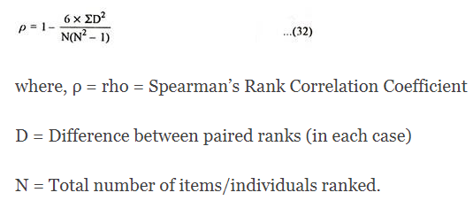
Spear man ranks correlation
There are some situations in Education and Psychology where the objects or individuals may be ranked and arranged in order of merit or proficiency on two variables and when these 2 sets of ranks covary or have agreement between them, we measure the degrees of relationship by rank correlation.
Again, there are problems in which the relationship among the measurements made is non-linear, and cannot be described by the product-moment r.
For example, the evaluation of a group of students on the basis of leadership ability, the ordering of women in a beauty contest, students ranked in order of preference or the pictures may be ranked according to their aesthetic values. Employees may be rank-ordered by supervisors on job performance.
School children may be ranked by teachers on social adjustment. In such cases objects or individuals may be ranked and arranged in order of merit or proficiency on two variables. Spearman has developed a formula called Rank Correlation Coefficient to measure the extent or degree of correlation between 2 sets of ranks.
This coefficient of correlation is denoted by Greek letter ρ (called Rho) and is given as:

Slide 106
1. In Rank Correlation Coefficient the observations or measurements of the bivariate variable is based on the ordinal scale in the form of ranks.
2. The size of the coefficient is directly affected by the size of the rank differences.
(a) If the ranks are the same for both tests, each rank difference will be zero and ultimately D² will be zero. This means that the correlation is perfect; i.e. 1.00.
(b) If the rank differences are very large, and the fraction is greater than one, then the correlation will be negative.
Assumptions of Rho (ρ):
i. N is small or the data are badly skewed.
ii. They are free, or independent, of some characteristics of the population distribution.
iii. In many situations Ranking methods are used, where quantitative measurements are not available.
iv. Though quantitative measurements are available, ranks are substituted to reduce arithmetical labour.
v. Such tests are described as non-parametric.
vi. In such cases the data are comprised of sets of ordinal numbers, 1st, 2nd, 3rd….Nth. These are replaced by the cardinal numbers 1, 2, 3,………, N for purposes of calculation. The substitution of cardinal numbers for ordinal numbers always assumes equality of intervals.

Slide 107
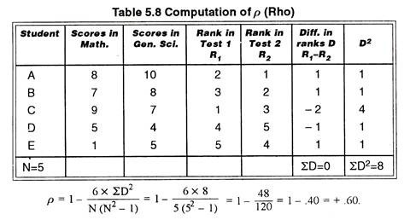


Slide 108
Mann Kendel’s correlation
Mann-Kendall trend test is a nonparametric test used to identify a trend in a series, even if there is a seasonal component in the series.
This test is the result of the development of the nonparametric trend test first proposed by Mann (1945). This test was further studied by Kendall (1975) and improved by Hirsch et al (1982, 1984) who allowed to take into account a seasonality.

Slide 109

Kendall rank correlation: Kendall rank correlation is a non-parametric test that measures the strength of dependence between two variables. If we consider two samples, a and b, where each sample size is n, we know that the total number of pairings with a b is n(n-1)/2. The following formula is used to calculate the value of Kendall rank correlation:
Nc= number of concordant Nd= Number of discordant

Slide 110
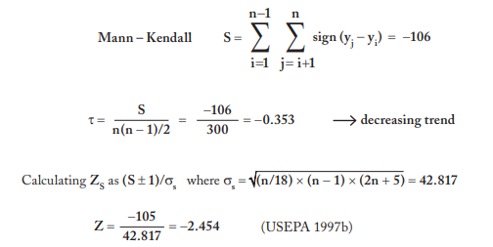
Trend analysis example 2: Mann-Kendall | value
1 | 0.18
5 | 0.2
9 | 0.25
13 | 0.068
17 | 0.201
21 | 0.063
25 | 0.099
29 | 0.125
33 | 0.205
37 | 0.078
41 | 0.216
45 | 0.059
49 | 0.098
53 | 0.102
57 | 0.137
61 | 0.037
65 | 0.1
69 | 0.051
73 | 0.18
77 | 0.06
81 | 0.095
85 | 0.021
89 | 0.12
93 | 0.063
97 | 0.035
97 | 0.035

Slide 111
Harmonic mean
The harmonic mean is a very specific type of average. It’s generally used when dealing with averages of units, like speed or other rates and ratios.
Harmonic mean is another type average which can be used when observation are rates or ratio. It is defined as the reciprocal of the arithmetic mean of reciprocal of the values. It may be used when variables are oxygen per hr, pulse rate per minute, calori consumption per day.

Slide 112

Harmonic mean of discrete series
Data: 1, 4,4
=3/(1/1+1/4+1/4)
=2

Slide 113
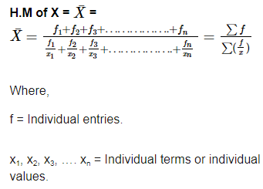
Hb% | Person (f) | mid vaolue (i) | f/i
10 to 12 | 5 | 11 | 0.45
12 to 14 | 8 | 13 | 0.62
14 to 16 | 5 | 15 | 0.33
16 to 18 | 2 | 17 | 0.12

Slide 114
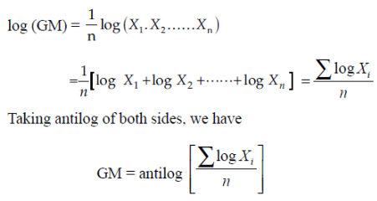
Geometric mean
Geometric mean of a series containing n observation is the nth root of product of observation. Suppose there are
4,6,24
Geometric mean= squre root of 4*6*24
= 24
Percentage increase in sale | log i
5 | 0.69897
10.5 | 1.021189
9 | 0.954243
6 | 0.778151
7.5 | 0.875061
Sum of log | 4.327614
Log value/5 | 0.865523
Antilog | 7.337

Slide 115
n mathematics, the logarithm is the inverse function to exponentiation. That means the logarithm of a given number xis the exponent to which another fixed number, the base b, must be raised, to produce that number x. In the simplest case the logarithm counts repeated multiplication of the same factor; e.g., since 1000 = 10 × 10 × 10 = 10³, the "logarithm to base 10" of 1000 is 3. The logarithm of x to base b is denoted as log_{b} (x) (or, without parentheses, as log_{b} x, or even without explicit base as log x, when no confusion is possible). More generally, exponentiation allows any positive real number to be raised to any real power, always producing a positive result, so the logarithm for any two positive real numbers b and x where b is not equal to 1, is always a unique real number y. More explicitly, the defining relation between exponentiation and logarithm is:
exactly if
For example, log₂ 64 = 6, as 64 = 2⁶.

Slide 116
Mean deviation
Mean deviation is defined as the average of absolute deviations of observations from mean, median and mode.
X | F | F*X | X-Xmean | positive value | F(x-x mean)
2 | 4 | 8 | -2.58 | 2.58 | 10.32
4 | 3 | 12 | -0.58 | 0.58 | 1.74
5 | 2 | 10 | 0.42 | 0.42 | 0.84
7 | 1 | 7 | 2.42 | 2.42 | 2.42
9 | 2 | 18 | 4.42 | 4.42 | 8.84
Sum | 12 | 55 |  | 10.42 | 24.16
 | X mean | 55/12 | 4.58
 | Mean deviation |  | 2.013
Mean = Sum(F*X)/sumF=
Mean deviation= sum fi (X-Xmean) (+value)/sumfi
= 2.013

Slide 117
Calculate the mean deviation from following dataset
X | F | F*X | X-Xmean | positive value | F(x-x mean)
5 to 10 | 5
10 to 15 | 7
15 to 20 | 1
20 to 25 | 1
25 to 30 | 4

Slide 118
Calculate the mean deviation, standard deviation, variance and standard error from following data set
15 to 19 | 17
20 to 24 | 22
25 to 29 | 27
30 to 34 | 32
35 to 39 | 37

Slide 119

Skewness
Skewness is the measure of extent of asymmetry in a given frequency curve. If a frequency curve is elongated to the right side , then it said to be positively skewed and opposite of this is negatively skewed. In a symettry mean, median and mode concide. In a positive skewed curve , mean>median>mode while in negatively skewed curve mode>median>mean.
Karl Pearson’s coeeficient of Skewness
Mo is mode and s is the standard deviation

Slide 120
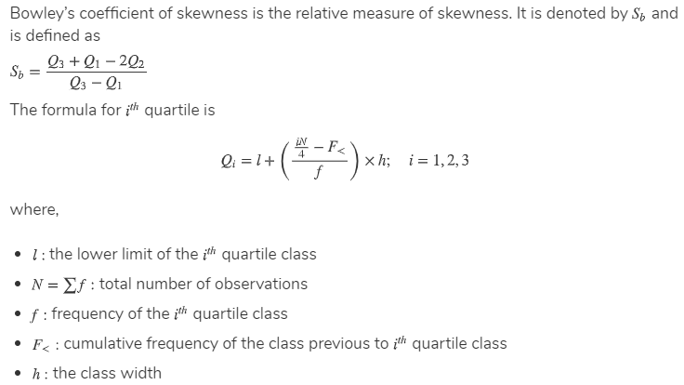
Bowley’s coefficient of skewness
Calculate the Bowley’s coefficient of following data set: 23, 44, 55, 12, 67, 21 and draw the graph of skewness

Slide 121
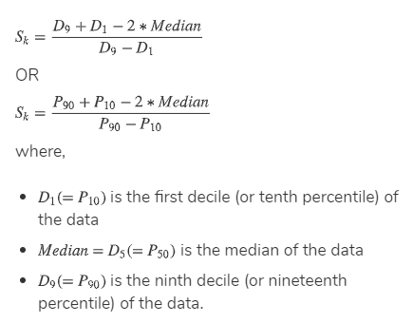
Kelley’s coefficient of Skewness
For a symmetric distribution, the first decile namely D1 and nineth decile D9 are equidistance from the median i.e. D5. Thus, D9−D5=D5−D1.
Kelly’s coefficient of skewness is based on deciles D1, 1st decile, D5, 5th decile, and D9, 9thdecile). Only 20% of the observations are excluded from the measure.

Slide 122
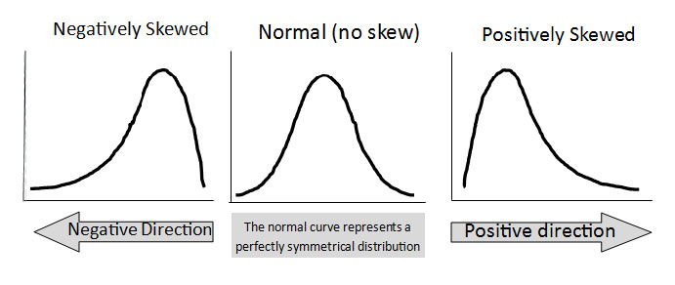
Types of skewness

Slide 123



Kurtosis
.
.
.
Kurtosis is measure of flatness of a distribution. Distribution can be classified into three groups with respect to extent of peakedness or flatness. They are 3 types
i. Mesokurtic: When the distribution is neither peaked nor flat and its graph results in that is known as normal curve.
ii. Leptokurtic: when the distribution is more peaked than the normal curve. . If the kurtosis is greater than zero, then the distribution has heavier tails and is called a leptokurtic distribution.
Iii. Platykurtic: When the distribution is flatter than the normal curve. If the kurtosis is less than zero, then the distribution is light tails and is called a platykurtic distribution.
The problem with both skewness and kurtosis is the impact of sample size.
The normal distribution is a symmetric distribution with well-behaved tails. This is indicated by the skewness of 0.03. The kurtosis of 2.96 is near the expected value of 3.
Normal distribution Mesokurtic distribution Kurtosis = 0
Leptokurtic distribution Fatter tails Kurtosis > 0
Platykurtic distribution.
Thinner tails Kurtosis <0

Slide 124
Moment of Kurtosis
B2=µ4/µ2
Let see the data set
First moment of Kurtosis= Sum (x- xmean)¹/n
second moment of Kurtosis = Sum (x- xmean)²/n
Third moment= Sum (x- xmean)³/n
Fourth moment= Sum (x- xmean)⁴/n
Calculate the moment of Kurtosis from following data set
Dat set
11
15
17
19
21

Slide 125
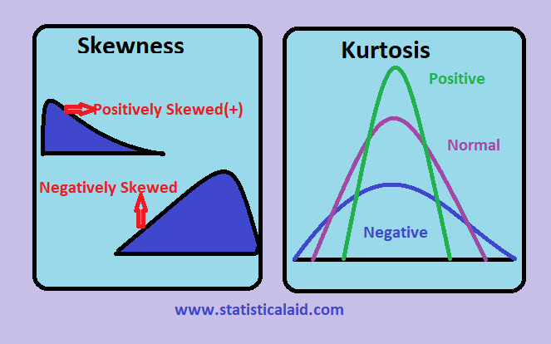

Slide 126
THANKS

